Slide 1
T4 -RDM
Shahar shamur
Professor Sharon Gilai - Dotan

Slide 2
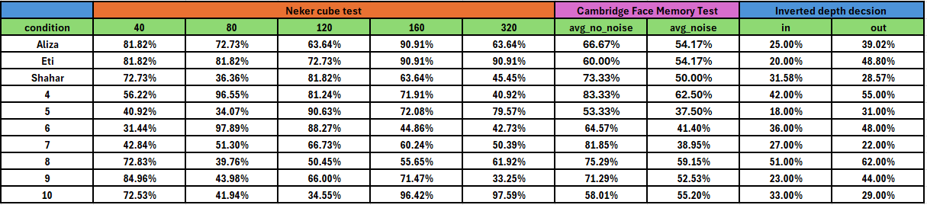
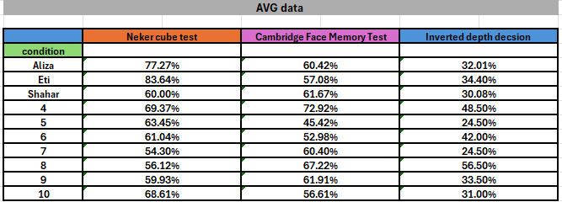

Slide 3
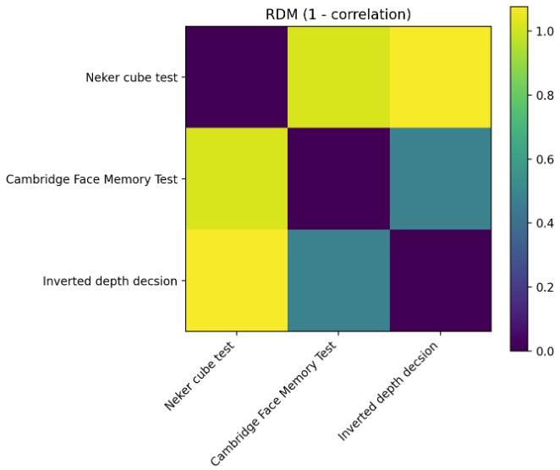
CHAT GPT -5

Slide 4
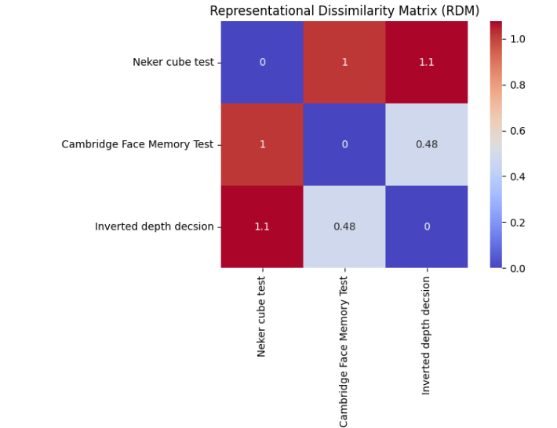
Perplexity

